Slide 1







Programing language and Database trend
Shubh Gaur
8-10-2021

Slide 2



OUTLINE
Executive Summary
Introduction
Methodology
Results
Visualization – Charts
Dashboard
Discussion
Findings & Implications
Conclusion
Appendix

Slide 3

EXECUTIVE SUMMARY
JavaScript is used by most of developers
Windows is preferred by most of the developers
MySQL is most used database
jQuery is most used Web framework
Python is growing language

Slide 4

INTRODUCTION
Perform Analysis on Language and database trends
Which Programing Language highest userbase.
Which type of database is in demand.
Top 2 web framework which is used for development.
This report help to understand language and database trends

Slide 5

METHODOLOGY
Dataset use csv file
Source of Database are survey
Use Linear regression
Correlation
Residential plot

Slide 6
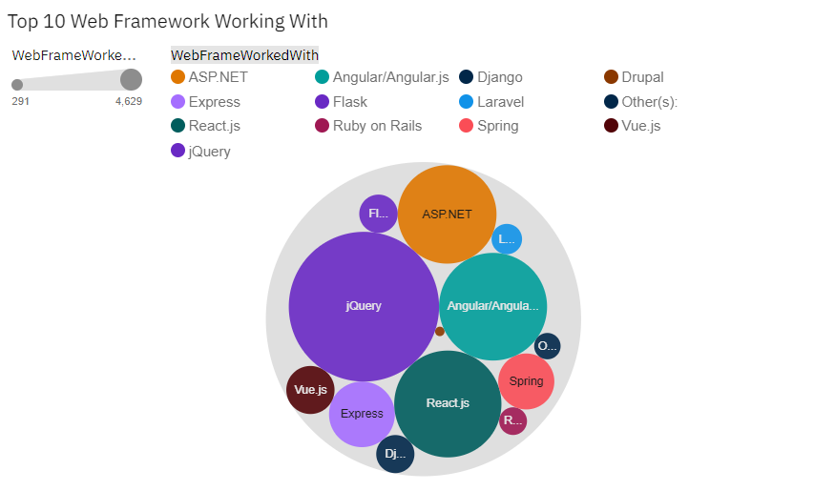
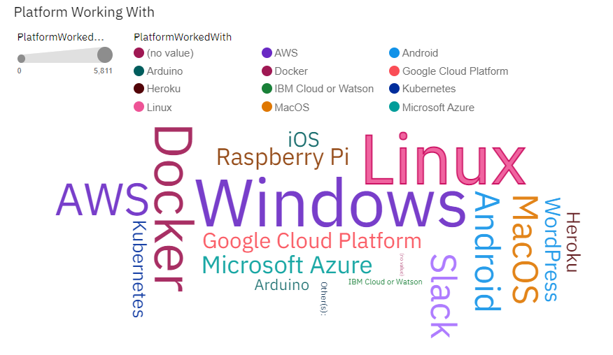
RESULTS

Slide 7
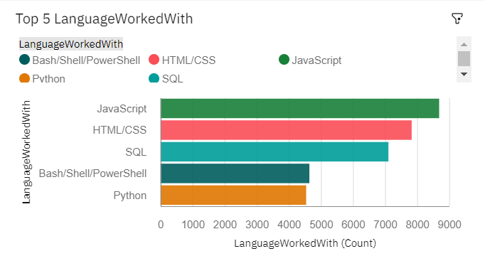
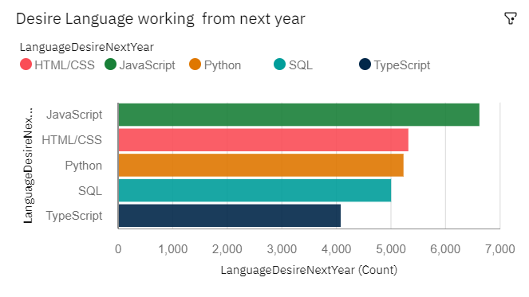
PROGRAMMING LANGUAGE TRENDS
Current Year
Next Year
<Bar chart of top 5 programming languages for the current year goes here.>
< Bar chart of top 5 programming languages for the next year goes here.>

Slide 8
PROGRAMMING LANGUAGE TRENDS - FINDINGS & IMPLICATIONS
Findings
Python is growing Language
SQL is desired language to generate query
JavaScript is more preferred than HTML/CSS
Implications
Python promote Machine learning
The demand of Relational database is growing
Due high demand backend is developed in JavaScript not in PHP

Slide 9
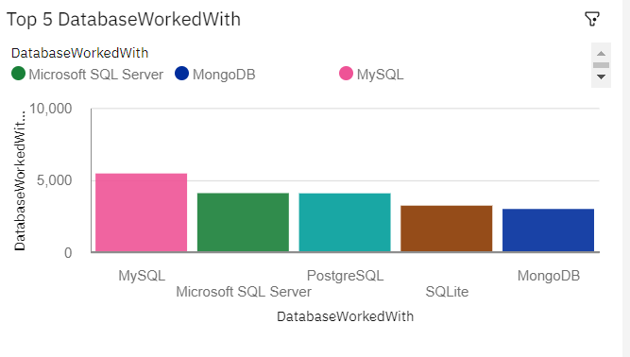
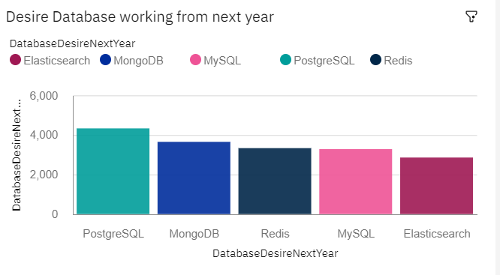
DATABASE TRENDS
Current Year
Next Year
< Bar chart of top 5 databases for the current year goes here >
< Bar chart of top 5 databases for the next year goes here.>

Slide 10
DATABASE TRENDS - FINDINGS & IMPLICATIONS
Findings
PostgreSQL has high growth than MySQL
Non-relational database is also growing rapidly
Finding 3
Implications
SQL has high demand in relational database
As the user unstructured data is increasing the non-relational database uses also increase
Implication 3

Slide 11

DASHBOARD
https://us1.ca.analytics.ibm.com/bi/?perspective=dashboard&pathRef=.my_folders%2FPeerGraded&id=iE501974E832B4B1B9E5C53EC632709B5&objRef=iE501974E832B4B1B9E5C53EC632709B5&options%5BdisableGlassPrefetch%5D=true&options%5Bcollections%5D%5BcanvasExtension%5D%5Bid%5D=com.ibm.bi.dashboard.canvasExtension&options%5Bcollections%5D%5BfeatureExtension%5D%5Bid%5D=com.ibm.bi.dashboard.core-features&options%5Bcollections%5D%5Bbuttons%5D%5Bid%5D=com.ibm.bi.dashboard.buttons&options%5Bcollections%5D%5Bwidget%5D%5Bid%5D=com.ibm.bi.dashboard.widgets&options%5Bcollections%5D%5BcontentFeatureExtension%5D%5Bid%5D=com.ibm.bi.dashboard.content-features&options%5Bcollections%5D%5BsaveServices%5D%5Bid%5D=com.ibm.bi.dashboard.saveServices&options%5Bcollections%5D%5Btemplates%5D%5Bid%5D=com.ibm.bi.dashboard.templates&options%5Bcollections%5D%5BvisualizationExtension%5D%5Bid%5D=com.ibm.bi.dashboard.visualizationExtensionCA&options%5Bcollections%5D%5BboardModel%5D%5Bid%5D=com.ibm.bi.dashboard.boardModelExtension&options%5Bcollections%5D%5BcontentTypes%5D%5Bid%5D=com.ibm.bi.dashboard.contentTypes&options%5Bcollections%5D%5BserviceExtension%5D%5Bid%5D=com.ibm.bi.dashboard.serviceExtension&options%5Bcollections%5D%5BlayoutExtension%5D%5Bid%5D=com.ibm.bi.dashboard.layoutExtension&options%5Bcollections%5D%5BcolorSetExtensions%5D%5Bid%5D=com.ibm.bi.dashboard.colorSetExtensions&options%5Bconfig%5D%5Bproduct%5D=CA&options%5Bconfig%5D%5BeditPropertiesLabel%5D=true&options%5Bconfig%5D%5BenableCustomVisualizations%5D=true&options%5Bconfig%5D%5BassetTags%5D%5B%5D=dashboard&options%5Bconfig%5D%5BfilterDock%5D=true&options%5Bconfig%5D%5BshowMembers%5D=true&options%5Bconfig%5D%5Bupgrades%5D=dashboard-core%2Fjs%2Fdashboard%2Fupgrades&options%5Bconfig%5D%5BassetType%5D=exploration&options%5Bconfig%5D%5BgeoService%5D=CA&options%5Bconfig%5D%5BsmartTitle%5D=true&options%5Bconfig%5D%5BnavigationGroupAction%5D=true&options%5Bconfig%5D%5BenableDataQuality%5D=false&options%5Bconfig%5D%5BmemberCalculation%5D=false&subView=model0000017b2a5e756f_00000002&isAuthoringMode=true&boardId=iE501974E832B4B1B9E5C53EC632709B5

Slide 12
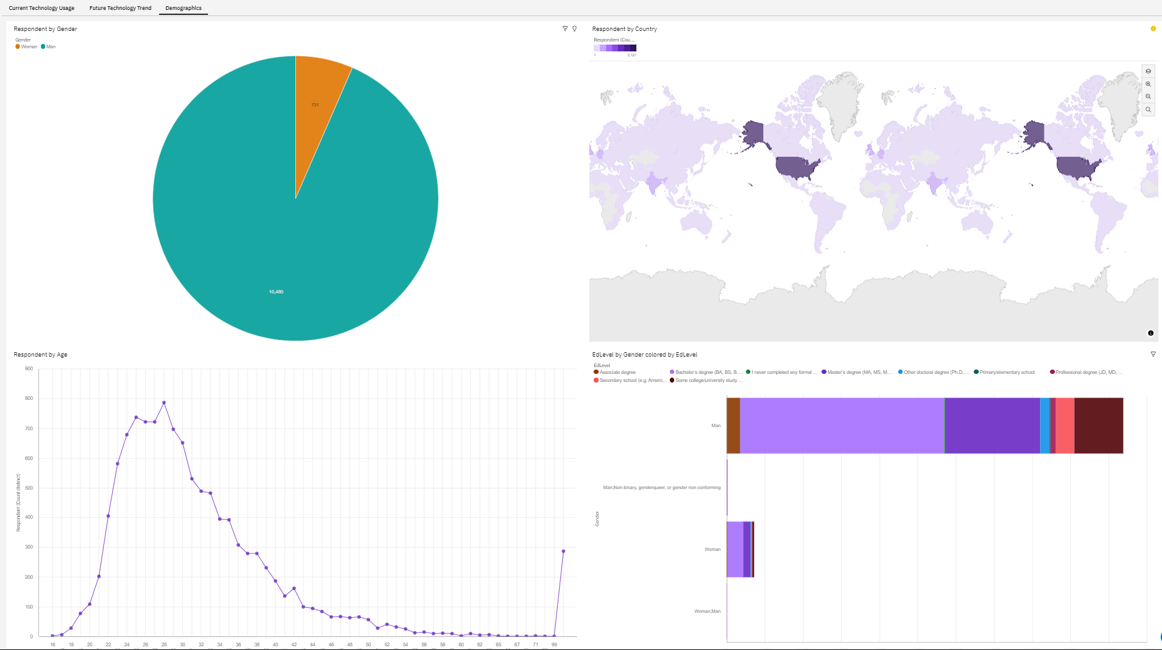
DASHBOARD TAB 1

Slide 13
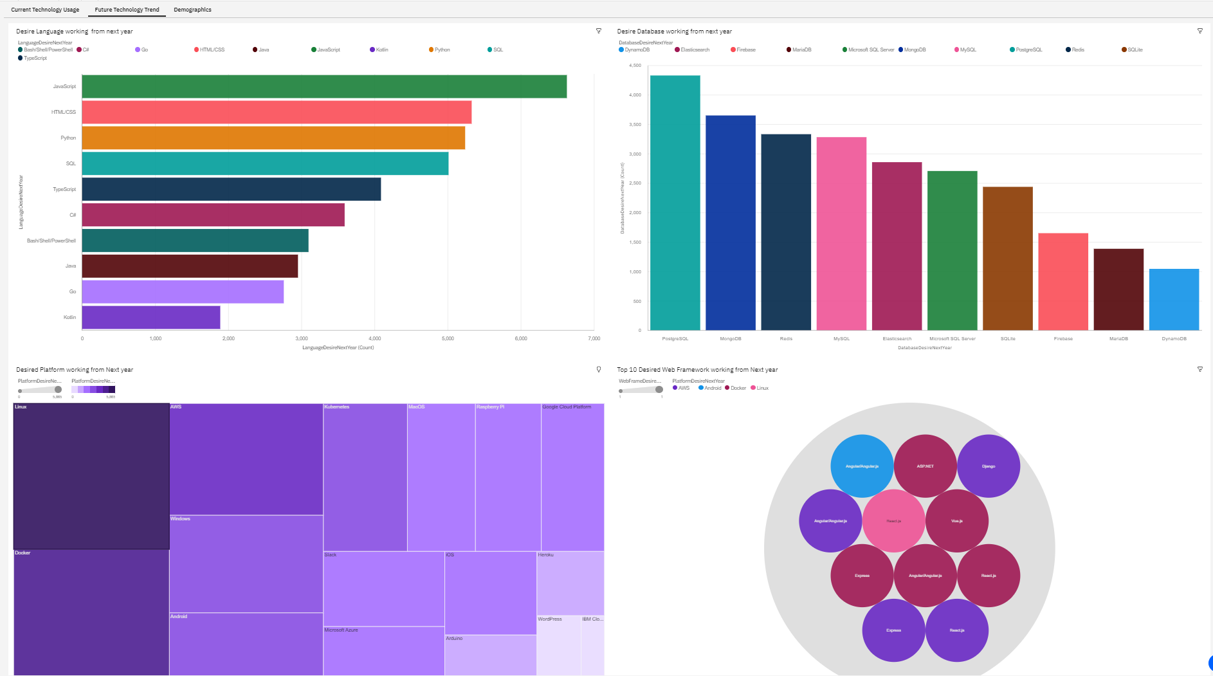
DASHBOARD TAB 2

Slide 14
DASHBOARD TAB 3

Slide 15
DISCUSSION
The student need to learn more than on languages to get in competition or one programing Language is Sufficient.
Which type of database is preferred by students.

Slide 16
OVERALL FINDINGS & IMPLICATIONS
Findings
jQuery and react.js is most used databases
JavaScript has high userbase than other programing language
SQL database is preferred over non-relational database
Implications
jQuery and React.js is promoting JavaScript
Python is growing rapidly may replace JavaScript
In future non-relational database uses is increases

Slide 17

CONCLUSION
JavaScript has high demand in current as well as in future.
SQL Database is preferred by most of developers
Windows based system is used for most of the development
jQuery is most used web framework

Slide 18

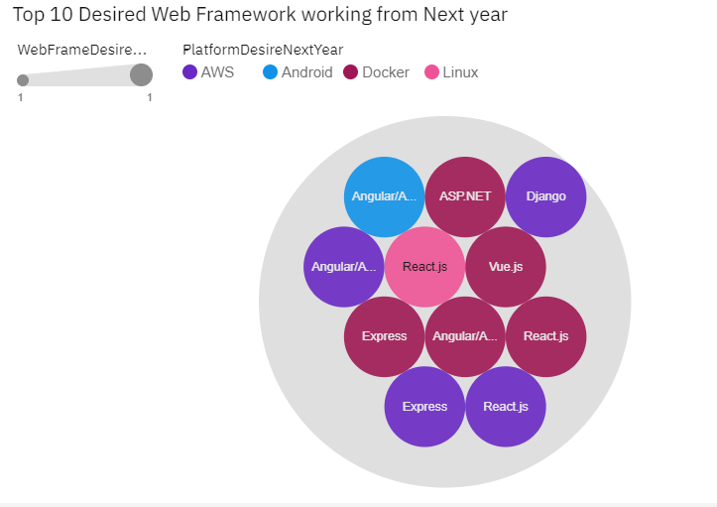
APPENDIX

